Slide 1




Web Applications and Services
ASP.NET Application Development
SoftUni Team
Technical Trainers
Software University
http://softuni.bg

Slide 2

Table of Contents
What is ASP.NET?
ASP.NET Infrastructure
ASP.NET Page Lifecycle and Management
Important stages
ASP.NET Event Model
State Management
Client-side state management
Server-side state management

Slide 3
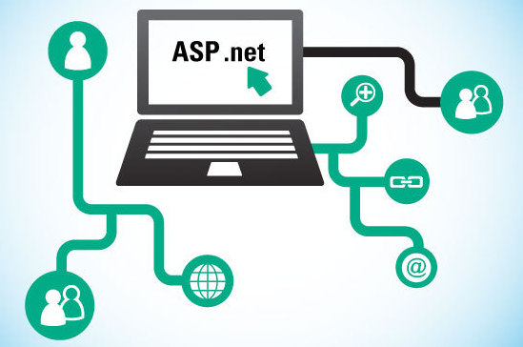
ASP.NET
ASP.NET is an open-source server-side web application framework designed for web development to produce dynamic web pages.
The ASP.NET infrastructure consists of:
Classes and interfaces that enable communication between web browsers and web servers
A runtime process that handles the web request for ASP.NET resources

Slide 4
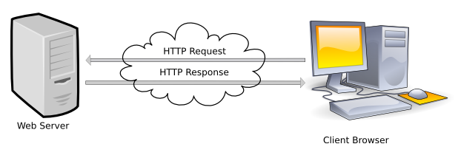
ASP.NET
An ASP.NET web application’s execution process consists of HTTP requests and response messages between the client browser and the Web server

Slide 5
ASP.NET Request Processing
Client
Request
Response
Request
ASP.NET ISAPI
IIS
Response
Generated Response
Processed
Request
Runtime Process
Assembly
Executed
Assembly
CLR
Services

Slide 6
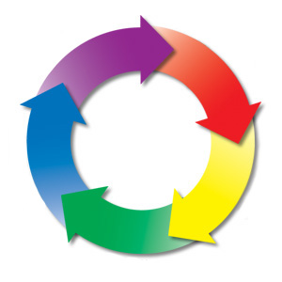
ASP.NET Page Lifecycle

Slide 7
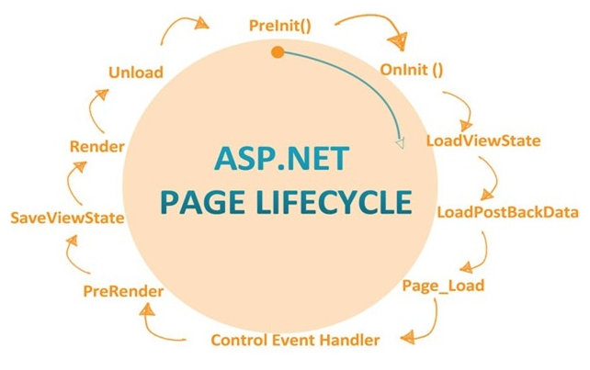
ASP.NET Page Lifecycle
When an ASP.NET page runs, the page goes through a life cycle in which it performs a series of processing steps
Initialization
Instantiating controls
Restoring and maintaining state
Running event handler code
Rendering

Slide 8
ASP.NET Page Lifecycle Stages
Page Request
The page request occurs before the page life cycle begins
Start
In the start stage, page properties such as Request and Response are set
Initialization
During page initialization, all the controls on the page are initialized
Load
During load, if the current request is a “postback”, control properties are loaded with information recovered from view state and control state

Slide 9
ASP.NET Page Lifecycle Stages
Postback event handling
If the request is a postback, control event handlers are called. After that the validator controls are called
Rendering
Before rendering, view state is saved for the page and all controls. During the rendering stage, each control is rendered
Unload
The Unload event is raised after the page has been fully rendered, sent to the client, and is ready to be discarded

Slide 10

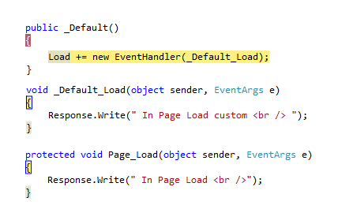
Live Demo

Slide 11
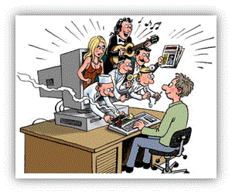
State Management

Slide 12
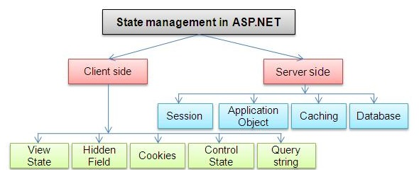
State Management
State management is an important issue for Web applications because of the disconnected nature of HTTP
There are client-side and server-side techniques for state management

Slide 13
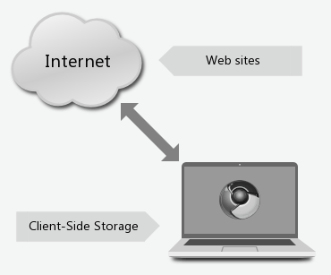
Client-side State Management
Storing page information using client-side options doesn't use server resources
Instead it stores it on the client computer
Several techniques for storing state information on the client side are:
Query strings
Cookies
Hidden fields
ViewState

Slide 14
Server-side State Management
Server-side state management uses server resources to store state information
ASP.NET supports server-side state management at two levels:
Session state
ASP.NET application creates a unique session for each user who sends a request to the application
Application state
Used to store data that is used throughout an application
can be easily accessed through the Application property of the Page class

Slide 15

Working with State Management

Slide 16

Summary
How to develop ASP.NET applications
Requests and Responses
Communication between client and server
Web page development
Page lifecycle
Page event model
State management
Client-side state management
Server-side state management

Slide 17








Questions
https://softuni.bg/courses/javascript-applications/

